Slide 1
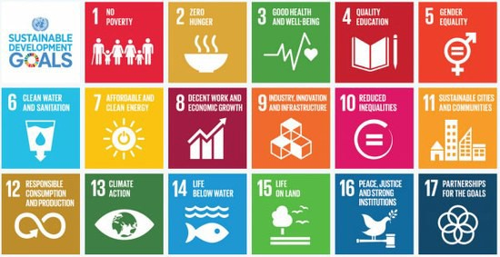
SUSTAINABLE DEVELOPMENT GOALS
SDgs

Slide 2
SUSUSTAINABLE DEVELOPMENT
Development that meets the needs of the present generation without compromising the needs of the future generation. When an economy adopts sustainable development strategy, its GDP growth rate may not be very high but it will sustain for a longer time period
The guiding principles for long term global development are structured under five pillars
people
planet
Prosperity
Peace
partnerships
United Nations in 2015 introduced 17 SDGs to be adopted for 2030 Agenda for sustainable development. These goals are also called as Global Goals

Slide 3
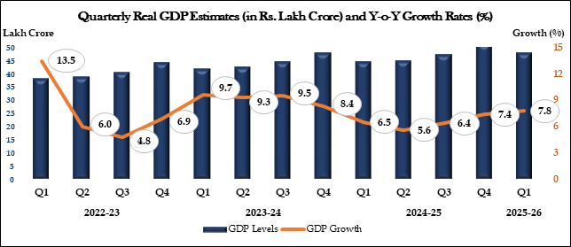
https://www.pib.gov.in/PressReleseDetailm.aspx?PRID=2161834

Slide 4
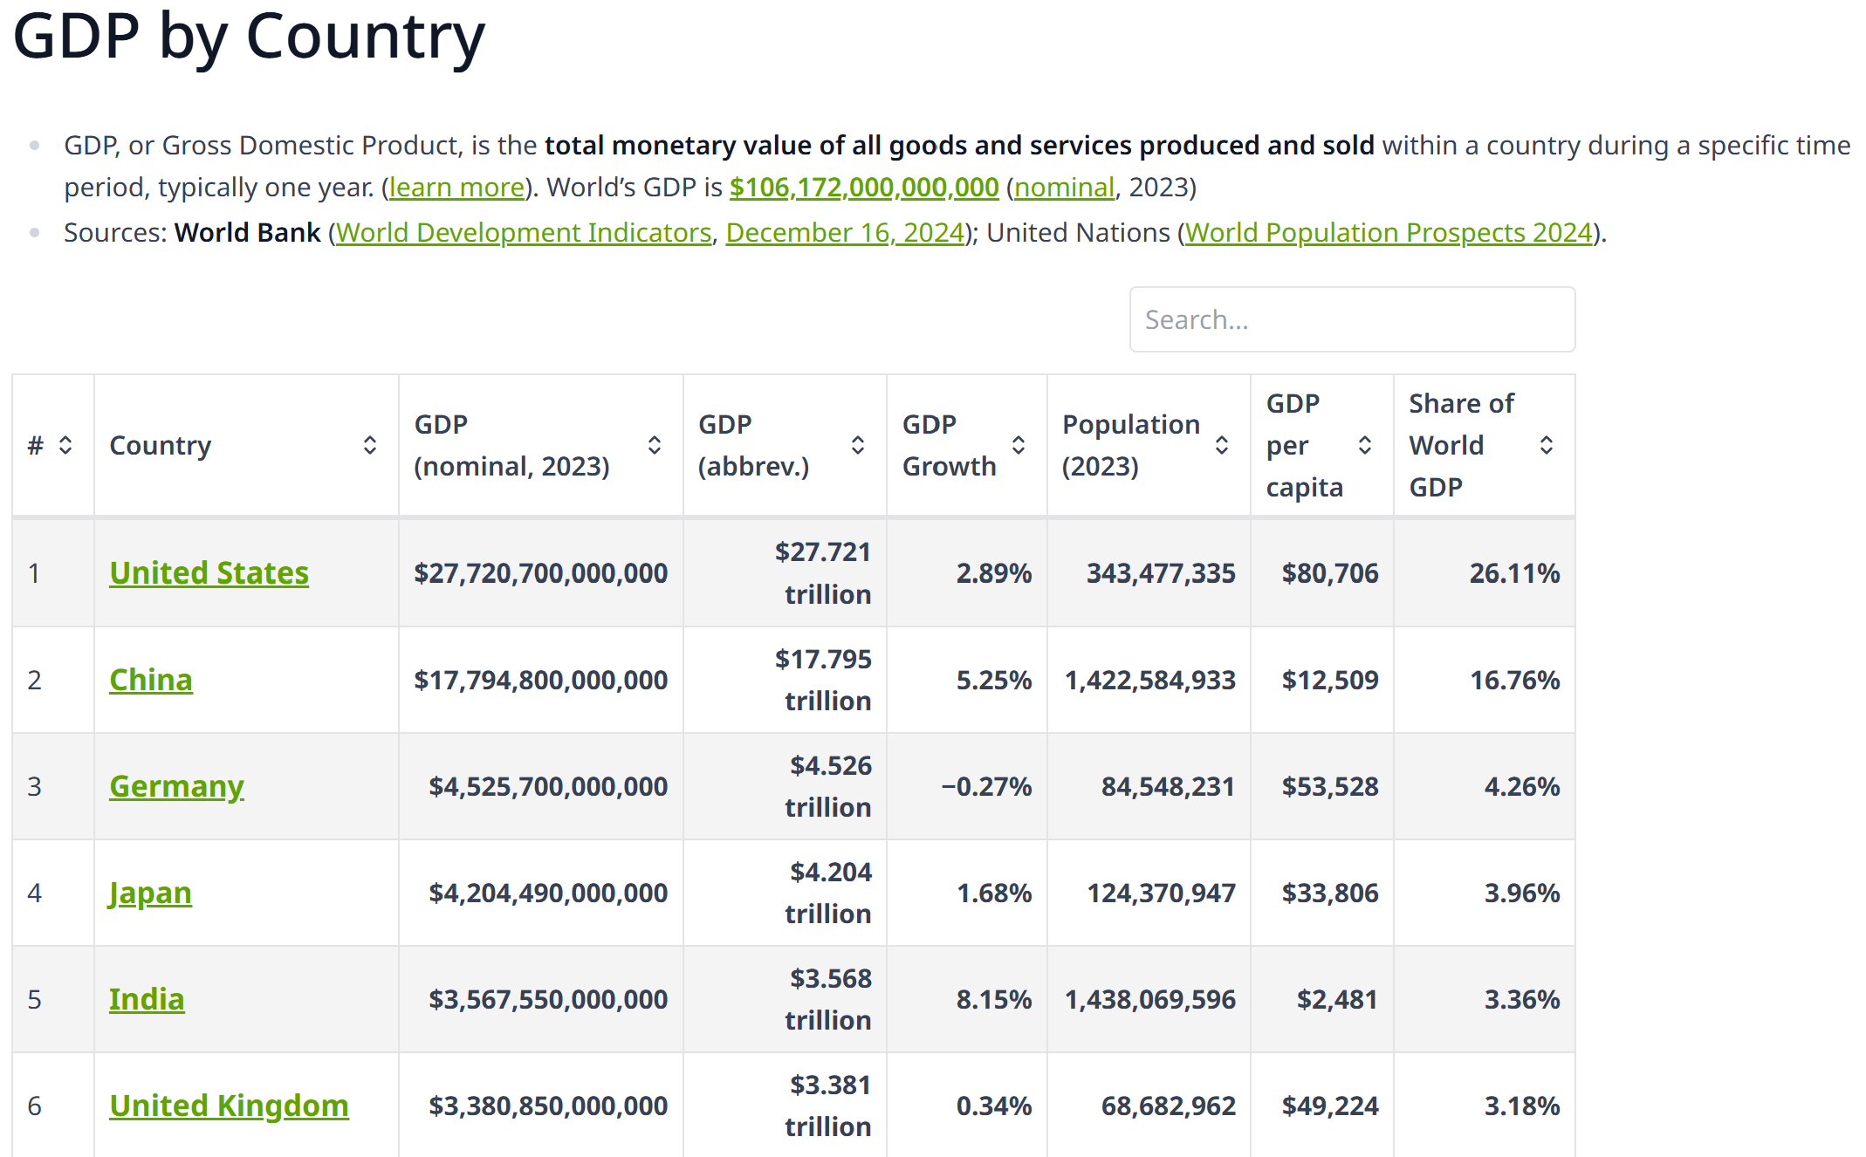

Slide 5
SUSUTAINABLE DEVELOPMENT INITIATIVES IN INDIA
India has succeeded in attaining the objective of economic growth
Development goals are yet lagging, for eg. in terms of HDI the rank is 130 out of 193 nations.
India has now adopted a strategy of inclusive growth for Vikasit Bharat @ 2047
NITI Aayog (National Institution for Transforming India) is the body responsible for achieving these goals
The Indian economy has initialed and implemented these programmes

Slide 6
17 SDGs of UNDP
No Poverty
Zero hunger
Good health & well being
Quality education
Gender equality
Clean water & sanitation
Affordable & clean energy
Decent work & economic work
Industry, innovation & infrastructure
Reduced inequality
Sustainable cities & production
Climate action
Life below water
Life on land
Peace & justice, strong institutions
Responsible consumption & production
Partnerships to achieve the goals

Slide 7
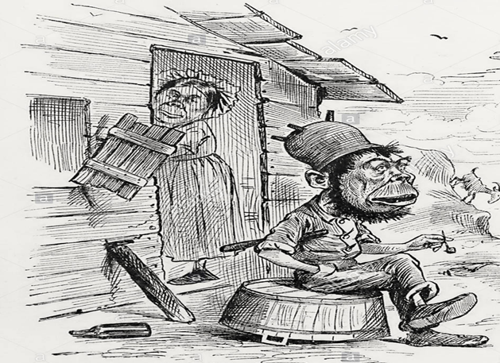
SDGs in India
India is the 4th largest economy in the world
as nominal GDP and 3rd largest by PPP
HDI rank is 130 among 193 countries
SDGs
Poverty has significantly declined from 9.5% in 2022-23
to 4.9% in 2023-24 (Indian Express, 29/05/2025)
Ending poverty –
MGNREGA – generated 85.06 crore man days of work by 2025
Deen Dayal Antyodaya Yojan – National livelihood Mission
Pradahan Mantri Jeevan Jyoti Bima and Pradhan Mantri Suraksha Yojanas
Atal Pension Yojana

Slide 8
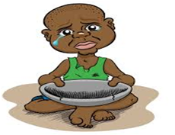
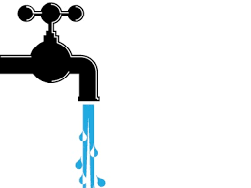
SDGs in India
2. Food security & Improved Nutrition
National food security program covers 9,78,44,394 benefeciaries
Digitalisation of ration cards 2,49,99,197 cards are digitalised
Land recovery under organic farming
health cards
By 2022 doubling farmers income, tenancy reforms, micro irrigation
1389 mandis of 23 States and 04 Union Territories (UTs) have been integrated with e-NAM platform
3. Healthy life & Well being for all
Expand national rural Drinking water Program
Award for hygienic environment
Target oriented National Health Policy 2017
Universal health insurance for families below BPL

Slide 9

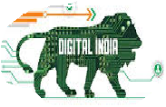
SDGs in India
4. Gender equity & empowerment of
women/girls
Beti Bachao Beti Padhao
Increased maternity benefits
Women empowerment centers at village levels
Infrastructure, Inclusive sustainable
industrialization and innovation
Expand all forms of transport
Digital India initiative
Make in India and Start up India program
Atal Innovation missions

Slide 10
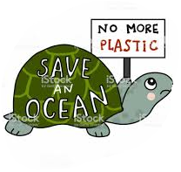


SDGs in India
6.Conserve and sustain marine resources
7. Global partnership for sustainable development
Enhancing development cooperation with neighboring economies

Slide 11
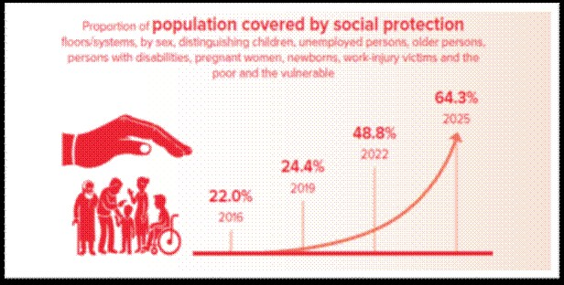
Highlights from the SDG NIF progress report 2025
https://www.pib.gov.in/PressReleasePage.aspx
The population covered by social protection systems/floors has increased from 22% in 2016 to 64.3% in 2025, indicating substantial expansion in social security coverage in the country.

Slide 12
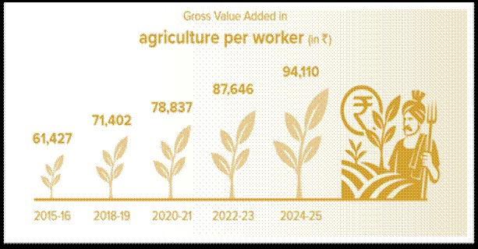
The Gross Value Added in agriculture per worker (in Rs.) has increased from 61,247 in 2015-16 to 94,110 in 2024-25, indicating improved agricultural productivity and income per worker in the country

Slide 13
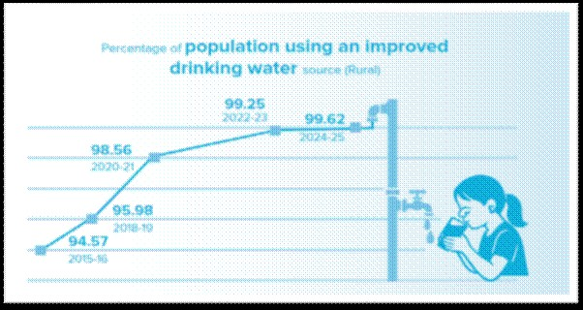
Percentage of population using an improved drinking water source in rural areas has increased from 94.57% in 2015-16 to 99.62% in 2024-25, indicating significant progress toward universal safe water access in rural India

Slide 14
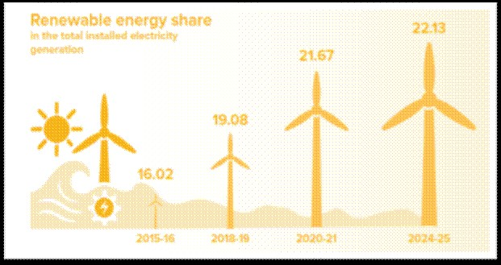
The renewable energy share in the total installed electricity generation has increased from 16.02 in 2015-16 to 22.13 in 2024-25, indicating consistent progress toward cleaner and sustainable energy generation in the country

Slide 15
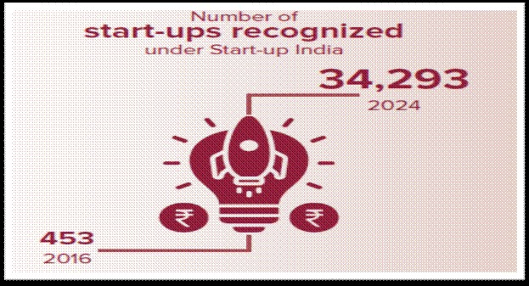
The number of start-ups recognised under start-up India have increased from 453 in 2016 to 34,293 in 2024, showing strong growth in entrepreneurship across the country.

Slide 16
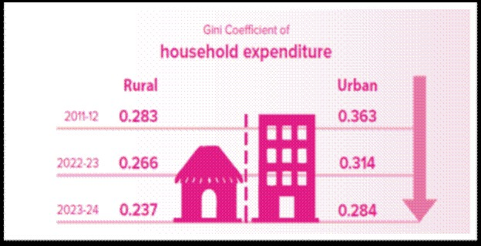
The Gini coefficient of household expenditure has decreased from 0.283 in 2011-12 to 0.237 in 2023-24 in rural areas. Also, for urban areas it has decreased from 0.363 in 2011-12 to 0.284 in 2023-24, showing a clear move toward more equal spending and reduced income inequality across both regions.

